Slide 1

Automatic Test Packet Generation

Slide 2
ABSTRACT
Test packets are sent periodically, and detected failures trigger a separate mechanism to localize the fault.
ATPG can detect both functional and performance problems .
ATPG complements but goes beyond earlier work in static checking ( which cannot detect liveness or performance faults) or fault localization (which only localize faults given liveness results).

Slide 3
EXISTING SYSTEM
Testing liveness of a network is a fundamental problem for ISPs and large data center operators.
Sending probes between every pair of edge ports is neither exhaustive nor scalable .
It suffices to find a minimal set of end-to-end packets that traverse each link.

Slide 4
DISADVANTAGES OF EXISTING SYSTEM
Not designed to identify liveness failures, bugs router hardware or software, or performance problems.
The two most common causes of network failure are hardware failures and software bugs, and that problems manifest themselves both as reachability failures and throughput/latency degradation.

Slide 5
PROPOSED SYSTEM
Automatic Test Packet Generation (ATPG) framework that automatically generates a minimal set of packets to test the liveness of the underlying topology and the congruence between data plane state and configuration specifications.
The tool can also automatically generate packets to test performance assertions such as packet latency.
It can also be specialized to generate a minimal set of packets that merely test every link for network liveness.

Slide 6
ADVANTAGES OF PROPOSED SYSTEM
A survey of network operators revealing common failures and root causes.
A test packet generation algorithm .
A fault localization algorithm to isolate faulty devices and rules.
ATPG use cases for functional and performance testing.
Evaluation of a prototype ATPG system using rule sets collected from the Stanford and Internet2 backbones.

Slide 7
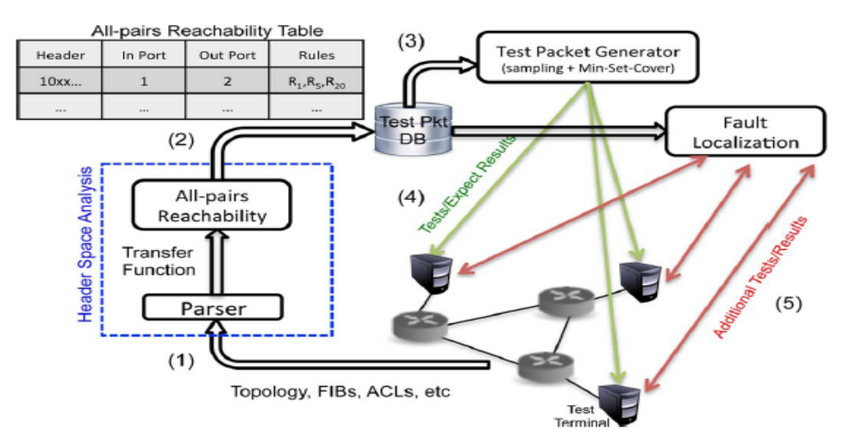
SYSTEM ARCHITECTURE

Slide 8
HARDWARE REQUIREMENTS
System : Pentium IV 2.4 GHz.
Hard Disk : 40 GB.
Floppy Drive : 1.44 Mb.
Monitor : 15 VGA Colour.
Mouse : Logitech.
Ram : 512 Mb.

Slide 9
SOFTWARE REQUIREMENTS
Operating system : Windows XP/7.
Coding Language : JAVA/J2EE
IDE : Netbeans 7.4
Database : MYSQL

Slide 10
REFERENCE
Hongyi Zeng, Peyman Kazemian,George Varghese,and Nick McKeown,“Automatic Test Packet Generation”,VOL. 22, NO. 2, APRIL 2014.

